Slide 1
Fahad Café Website Application
Markup Language
COMP 436
Fall 2018
Fahad
Dr. Nick Hayward​

Slide 2
Define My Project
What is the goal of my project
Future business
to provide communities with the ability to access the Internet, enjoy a cup of coffee, and share experiences in a comfortable atmosphere
to let customers feel appreciated, supported and satisfied, every time they come in.
What is my audience
This website is targeting ( All ages)

Slide 3
Plan Out Everything
There is some text in the websites, images , icon, maps
Websites that I’m going to use http://www.responsivegridsystem.com/ https://fonts.google.com/ - https://www.foodiesfeed.com/ - https://www.pexels.com/ - http://thestocks.im/ - all of them are free to use.
For social media icons and other icons: https://ionicons.com/
For the menu part, I'm going to use Starbucks or Dunkin Donuts menu There is a navigation part where people can sign up, reserving table, exploring the menu and seeing other’s people reviews about the café

Slide 4
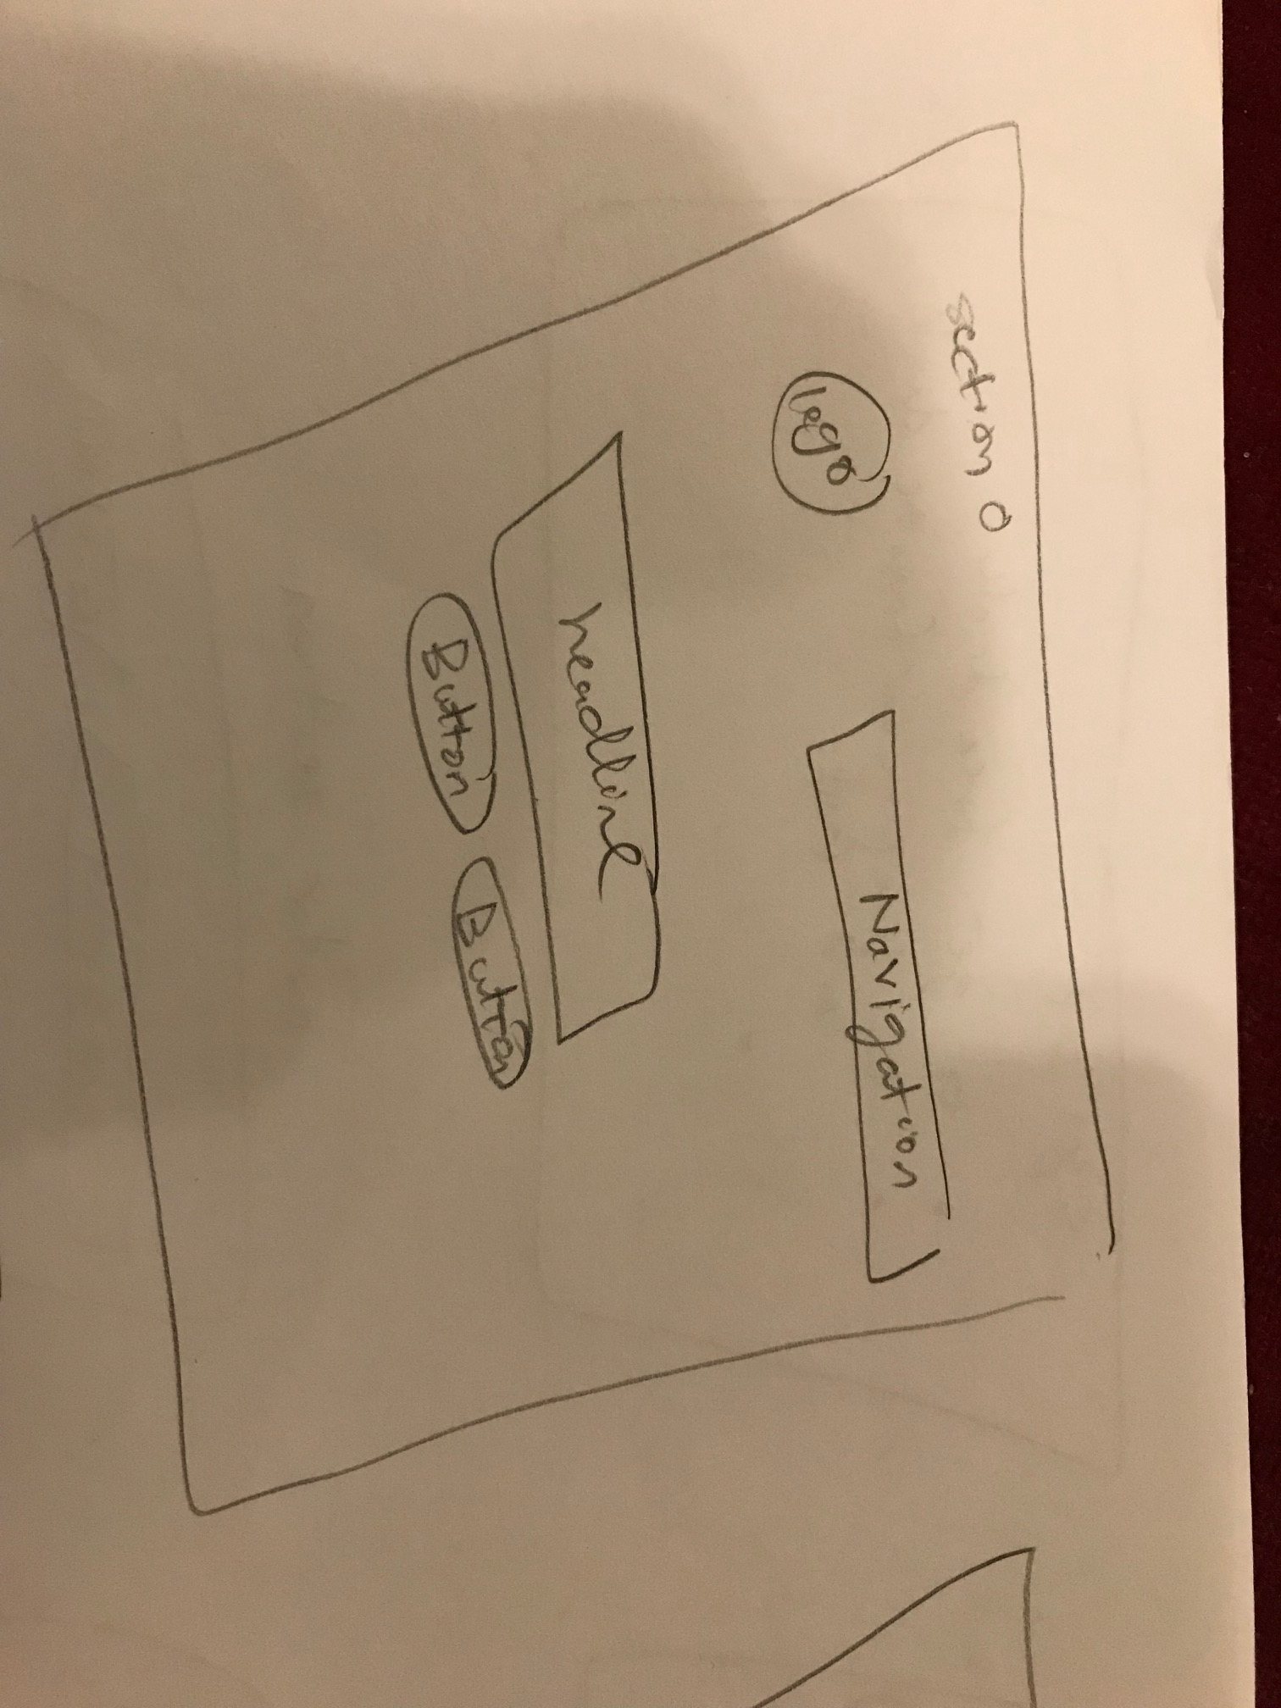
Sketch My Ideas Before Designing
Get inspired by responsive design websites

Slide 5
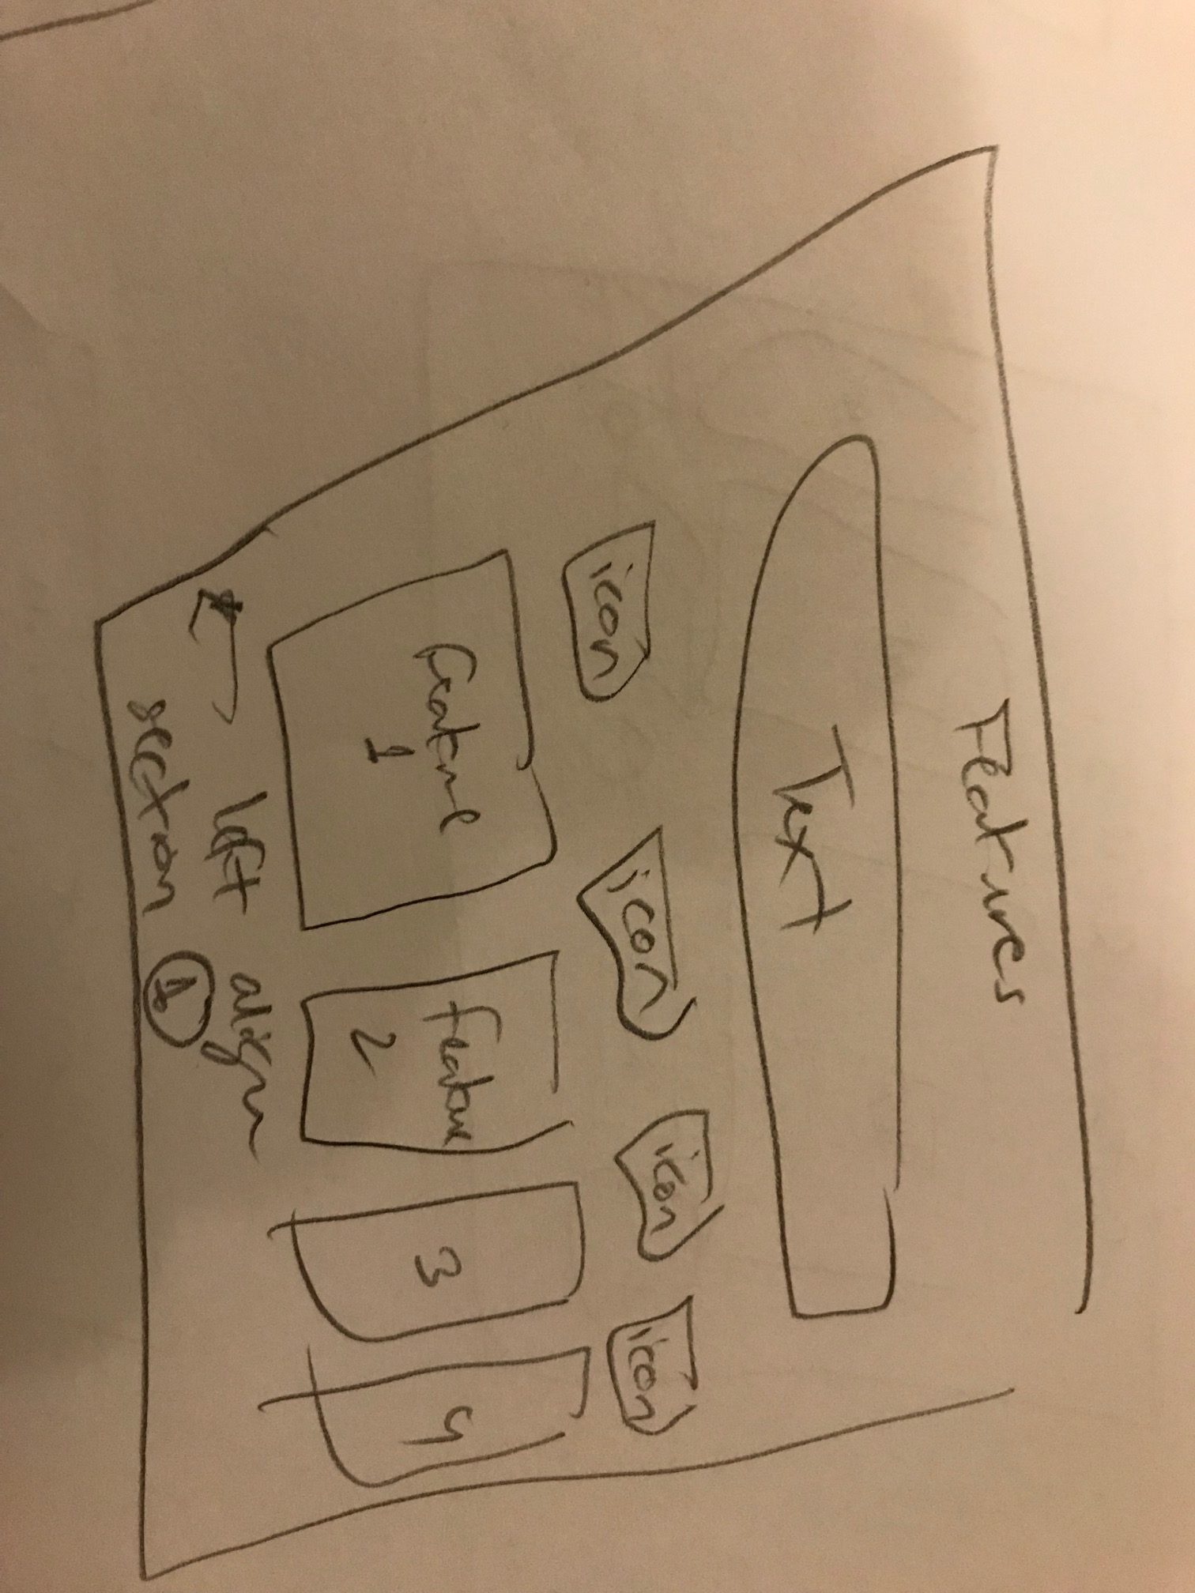
Sketch My Ideas Before Designing

Slide 6
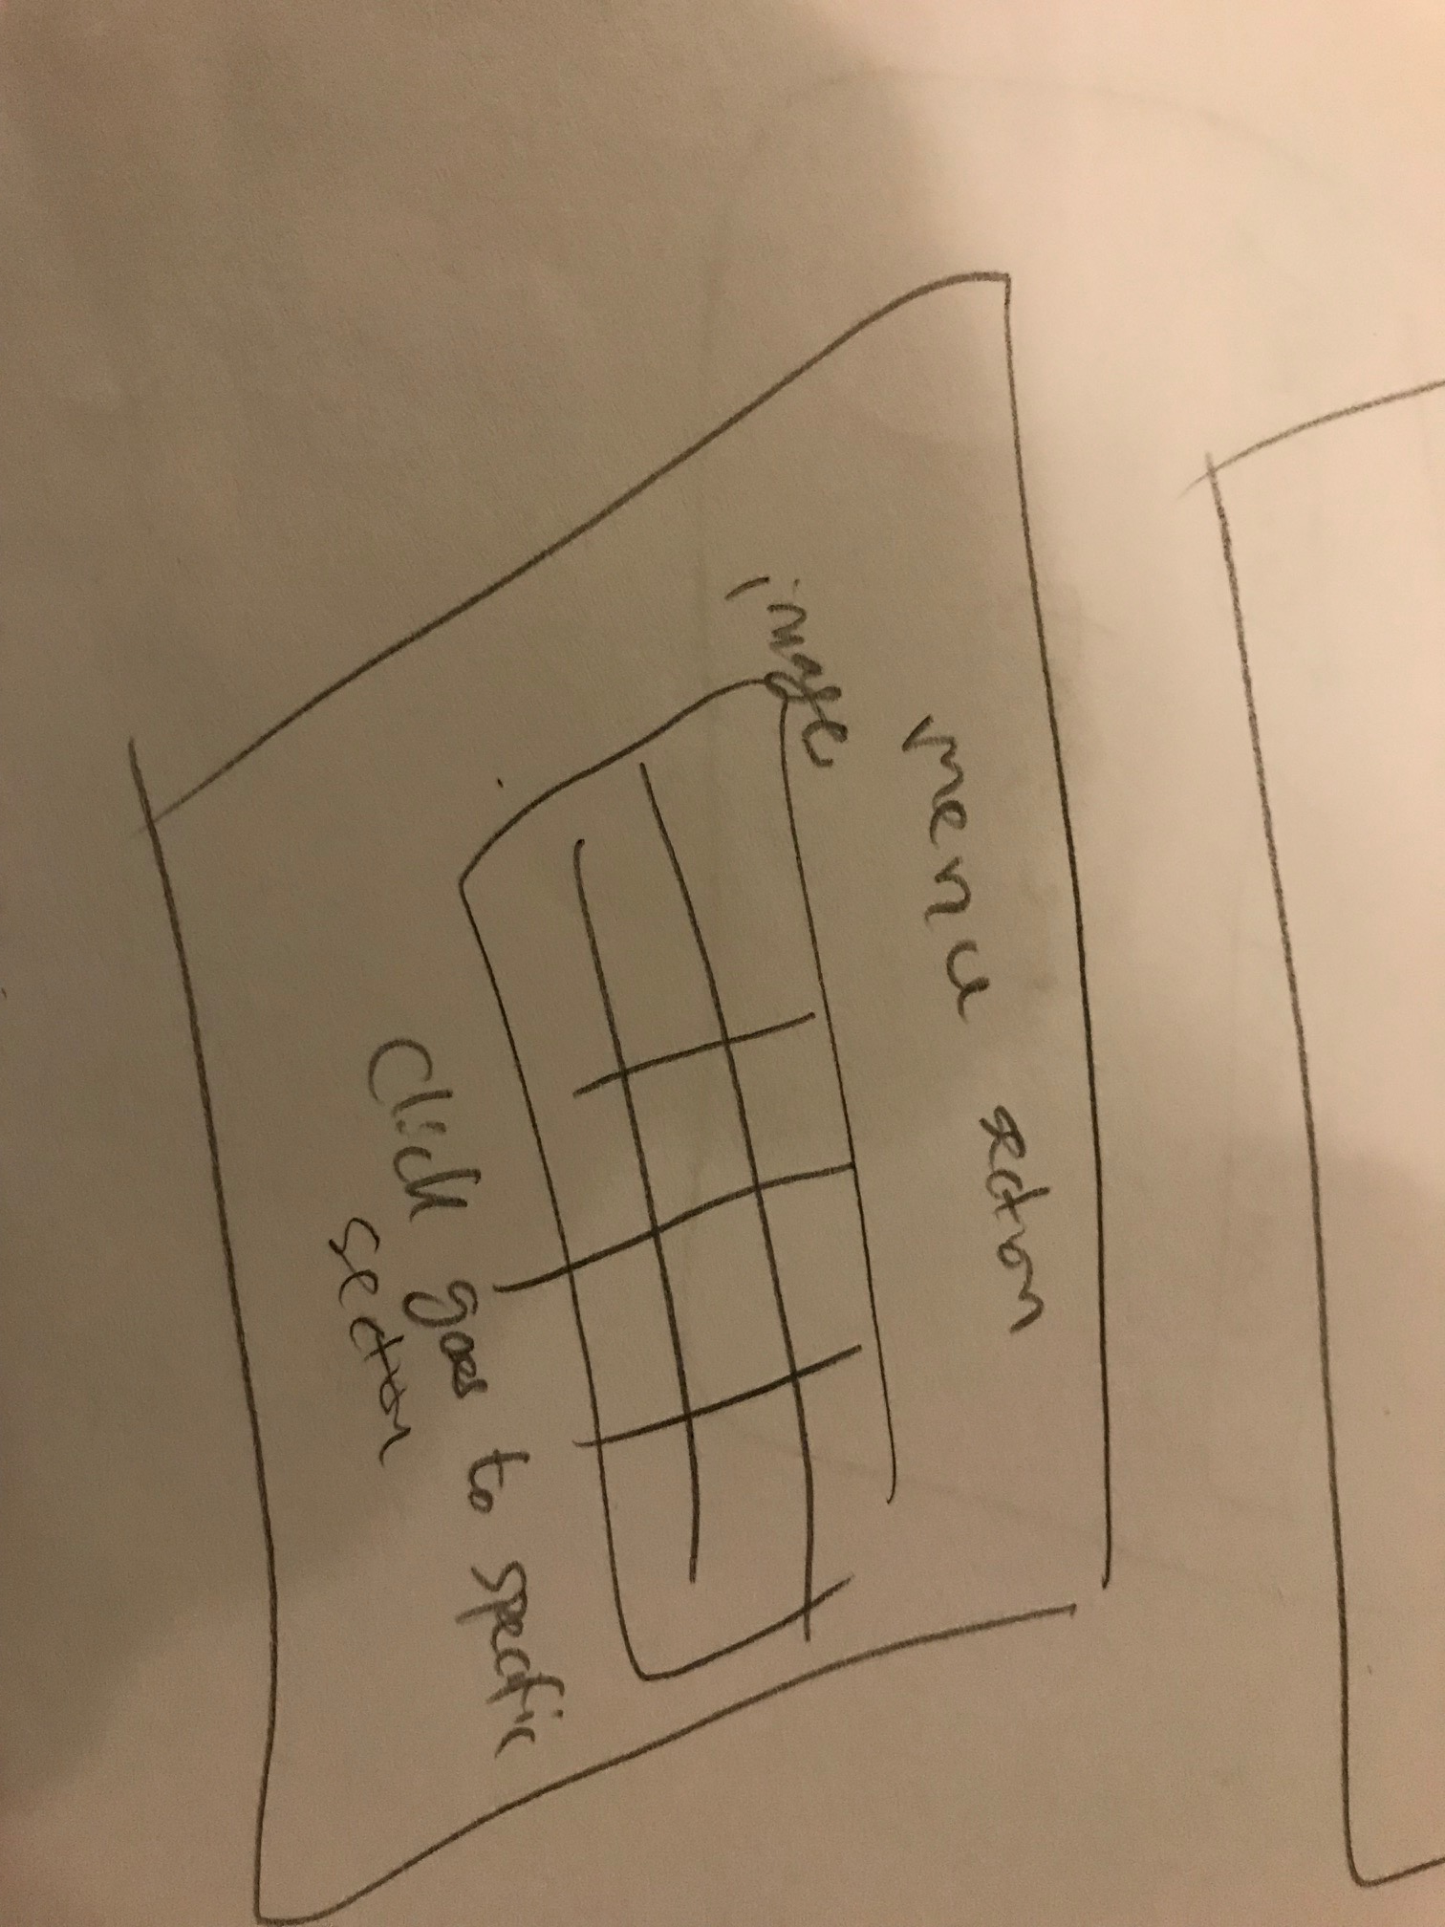
Sketch My Ideas Before Designing

Slide 7
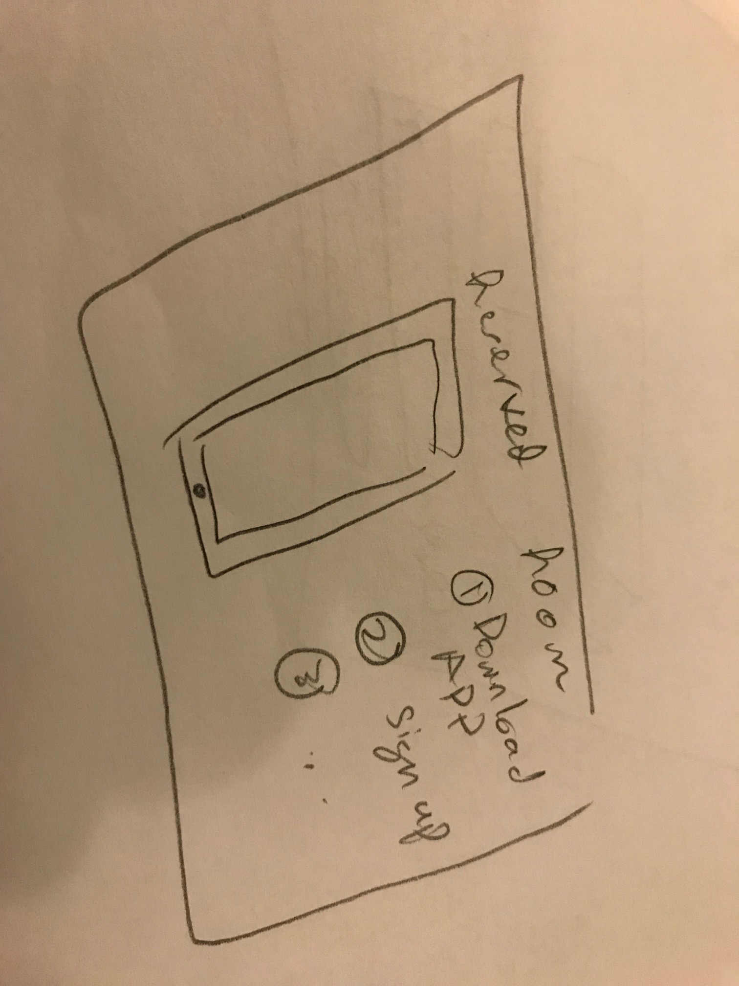
Sketch My Ideas Before Designing

Slide 8
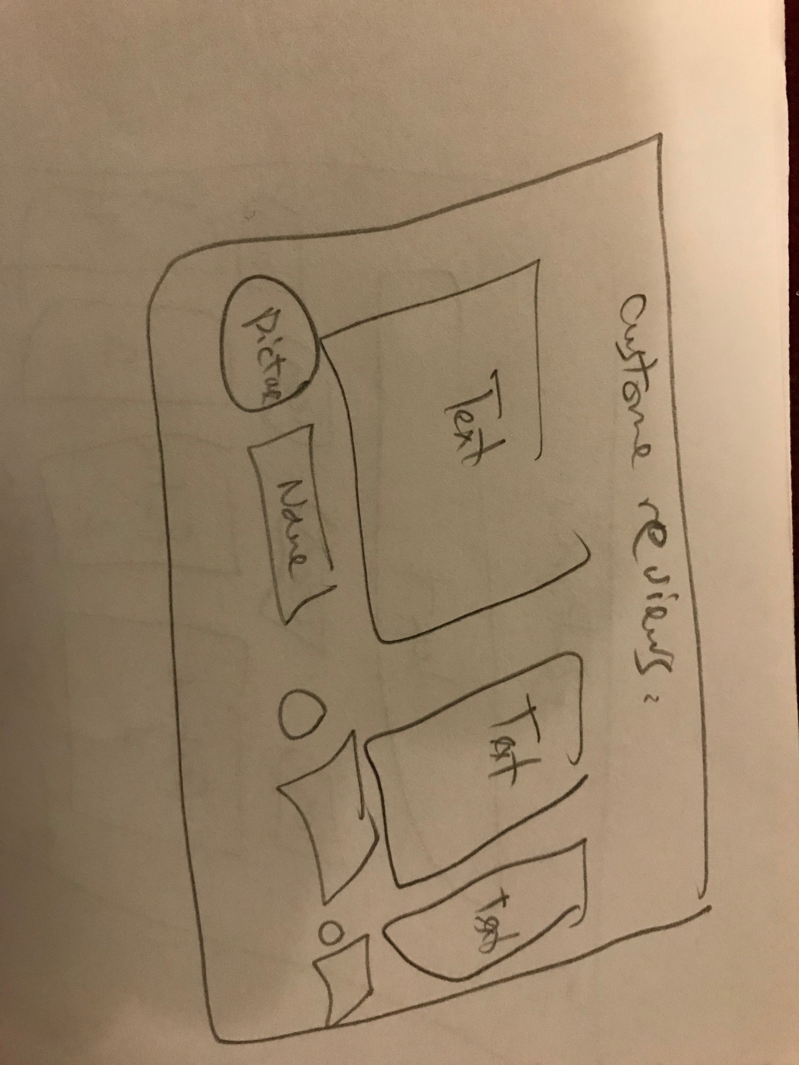
Sketch My Ideas Before Designing

Slide 9
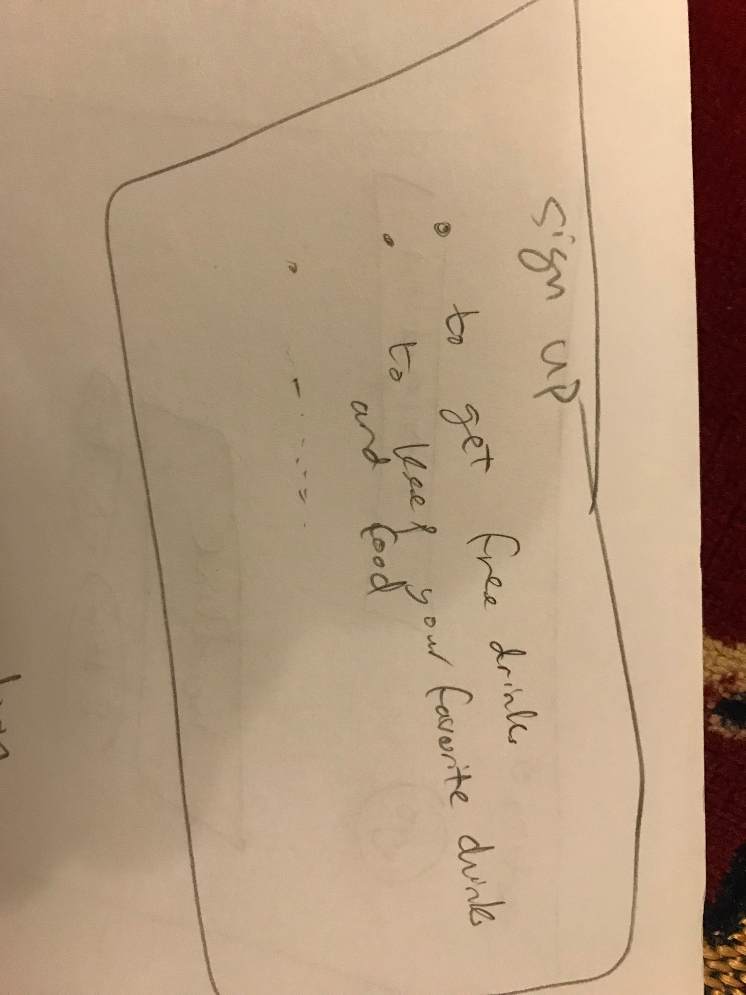
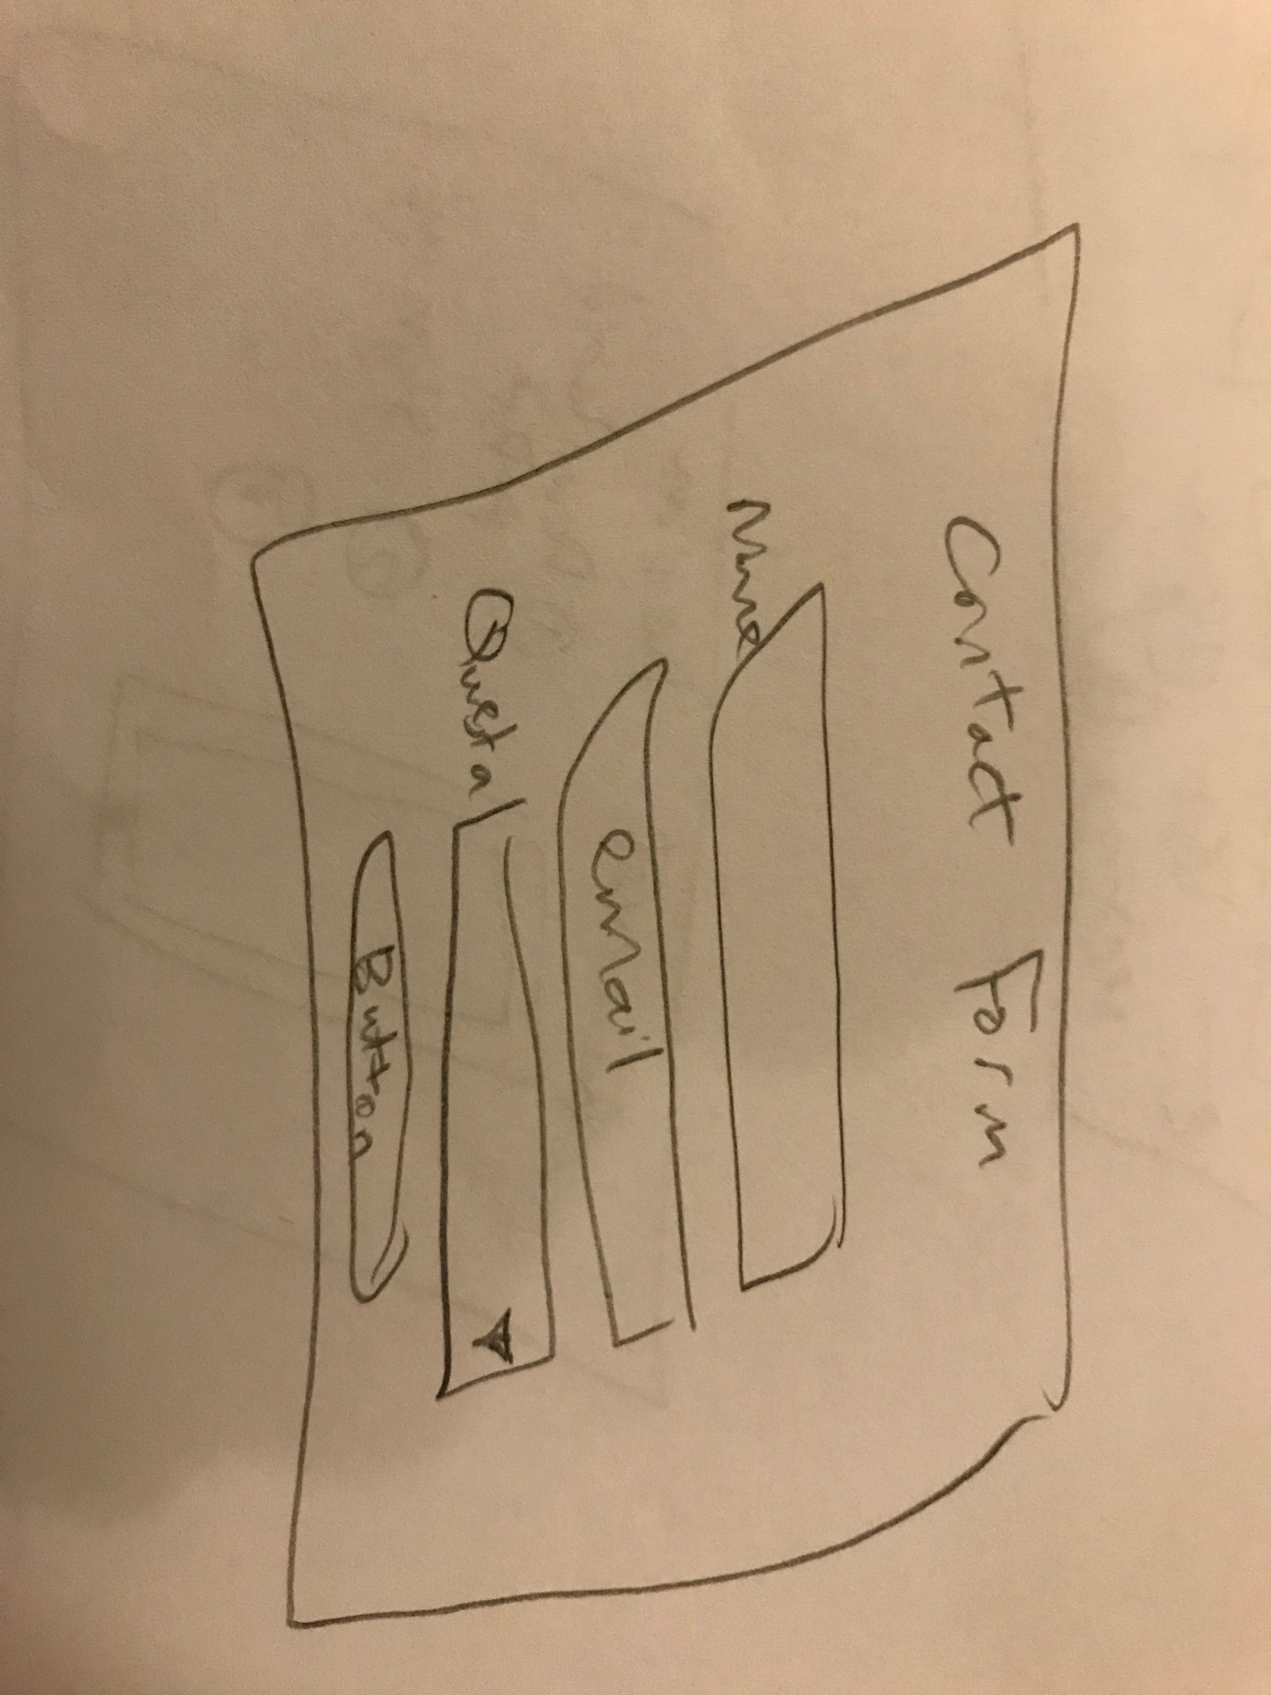
Sketch My Ideas Before Designing

Slide 10
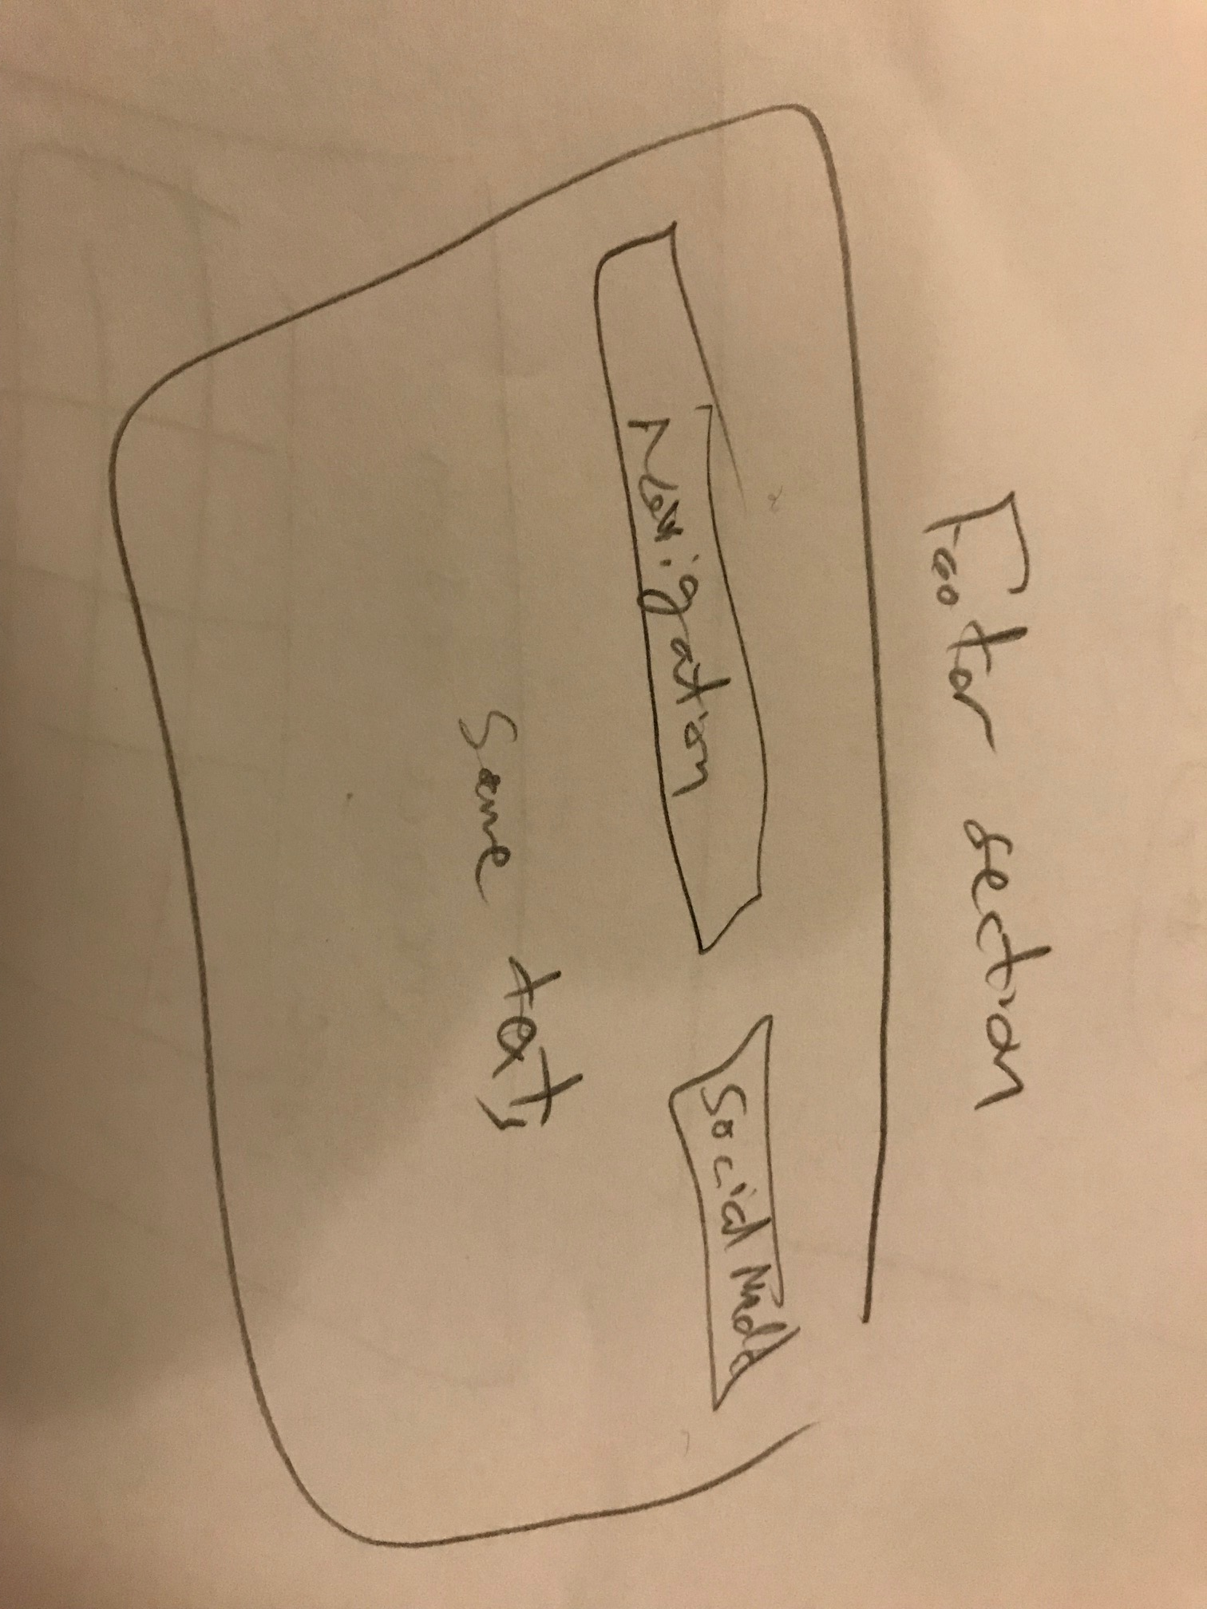
Sketch My Ideas Before Designing

Slide 11
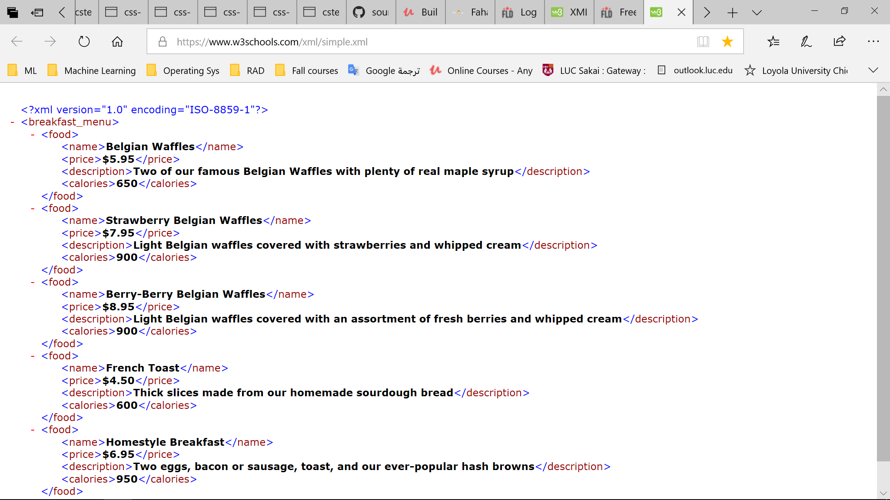
XML Menu Tree

Slide 12
My Website so far
index..\..\Fahad Cafe\index.html

Slide 13
Q&A

Slide 14
END.
Thank you.

